Slide 1
Query processing with an inverted index

Slide 2
The index we just built
Sec. 1.3
How do we process a query?
Later - what kinds of queries can we process?
Our focus

Slide 3
Query processing: AND
Sec. 1.3
Consider processing the query:
Brutus AND Caesar
Locate Brutus in the Dictionary;
Retrieve its postings.
Locate Caesar in the Dictionary;
Retrieve its postings.
“Merge” the two postings (intersect the document sets):
2
4
8
16
32
64
128
Brutus
1
2
3
5
8
13
21
34
Caesar

Slide 4
The merge
Sec. 1.3
Walk through the two postings simultaneously, in time linear in the total number of postings entries
2
4
8
16
32
64
128
Brutus
1
2
3
5
8
13
21
34
Caesar
If the list lengths are x and y, the merge takes O(x+y)
operations.
Crucial: postings sorted by docID.

Slide 5
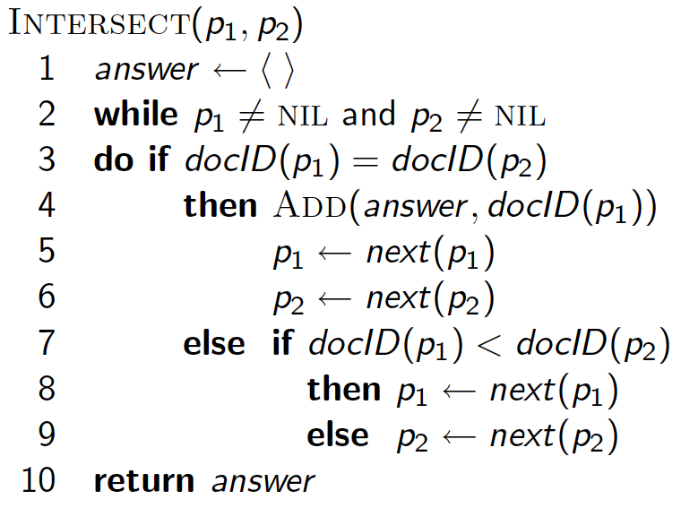
Intersecting two postings lists (a “merge” algorithm)

Slide 6
Query processing with an inverted index

